Slide 1

Context-Free Grammars
Chapter 11

Slide 2
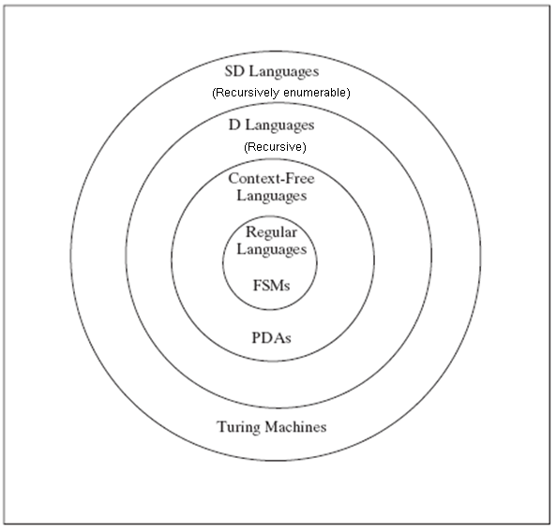
Languages and Machines

Slide 3
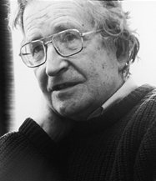
Background
Context-free grammars play a central role in the description and design of programming languages and compilers
They are also used for analyzing the syntax of natural languages.
Developed by Noam Chomsky in mid 50’s
1928 –
Professor emeritus at MIT
Father of modern linguistics
Still holds office
Controversial political critic
Often receives undercover
police protection

Slide 4
Rewrite Systems and Grammars
A rewrite system (or production system or rule-based system) is:
● a list of rules, and
● an algorithm for applying them
Each rule has a left-hand side and a right hand side.
Example rules:
S → aSb
aS → ε
aSb → bSabSa

Slide 5
Simple-rewrite
simple-rewrite(R: rewrite system, w: initial string) =
1. Set working-string to w.
2. Until told by R to halt do:
  Match the lhs of some rule against some part of working-string.
  Replace the matched part of working-string with the rhs of the rule that was matched.
3. Return working-string.
If simple-rewrite(R, w) can return some string s, then we say that R can drive s from w

Slide 6
A Rewrite System Formalism
A rewrite system formalism specifies:
● The form of the rules
● How simple-rewrite works:
● How to choose rules?
● When to quit?

Slide 7
An Example
w = SaS
Rules:
S → aSb
aS → ε
● What order to apply the rules?
● When to quit?

Slide 8
Rule Based Systems
● Expert systems
● Cognitive modeling
● Business practice modeling
● General models of computation
● Grammars
  G
  L(G)

Slide 9
Grammars Define Languages
A grammar has a set of rules, and works with an alphabet, that can be divided into two subsets:
a terminal alphabet, Σ, that contains the symbols that make up the strings in L(G), and
a nonterminal alphabet, the elements of which will function as working symbols that will be used while the grammar is operating. These symbols will disappear by the time the grammar finishes its job and generates a string.
A grammar has a unique start symbol, often called S.

Slide 10
Using a Grammar to Derive a String
Simple-rewrite (G, S) will generate the strings in L(G).
We will use the symbol ⇒ to indicate steps in a derivation.
A derivation could begin with:
S ⇒ aSb ⇒ aaSbb ⇒ …

Slide 11
Generating Many Strings
Multiple rules may match.
Given: S → aSb, S → bSa, and S → ε
Derivation so far: S ⇒ aSb ⇒ aaSbb ⇒
Three choices at the next step:
S ⇒ aSb ⇒ aaSbb ⇒ aaaSbbb (using rule 1),
S ⇒ aSb ⇒ aaSbb ⇒ aabSabb (using rule 2),
S ⇒ aSb ⇒ aaSbb ⇒ aabb (using rule 3).

Slide 12
Generating Many Strings
One rule may match in more than one way.
Given: S → aTTb, T → bTa, and T → ε
Derivation so far: S ⇒ aTTb ⇒
Two choices at the next step:
S ⇒ aTTb ⇒ abTaTb ⇒
S ⇒ aTTb ⇒ aTbTab ⇒

Slide 13
When to Stop
May stop when:
The working string no longer contains any nonterminal symbols (including, when it is ε).
In this case, we say that the working string is generated by the grammar.
Example:
S ⇒ aSb ⇒ aaSbb ⇒ aabb

Slide 14
When to Stop
May stop when:
There are nonterminal symbols in the working string but none of them appears on the left-hand side of any rule in the grammar.
In this case, we have a blocked or non-terminated derivation but no generated string.
Example:
Rules: S → aSb, S → bTa, and S → ε
Derivations: S ⇒ aSb ⇒ abTab ⇒ [blocked]

Slide 15
When to Stop
It is possible that neither (1) nor (2) is achieved.
Example:
G contains only the rules S → Ba and B → bB, with S the start symbol.
Then all derivations proceed as:
S ⇒ Ba ⇒ bBa ⇒ bbBa ⇒ bbbBa ⇒ bbbbBa ⇒ ...
So the grammar generates the language φ

Slide 16
Context-free Grammars, Languages, and PDAs
Generates
Context-free Language
Context-free Grammar
Recognizes
or
Accepts
PDA

Slide 17
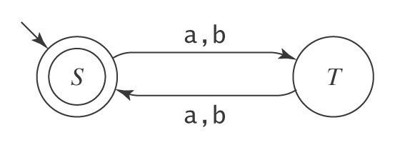
Recall Regular Grammar
Have a left-hand side that is a single nonterminal
Have a right-hand side that is ε or a single terminal or a single terminal followed by a single nonterminal
Regular grammars must always produce strings one character at a time, moving left to right.
L = {w ∈ {a, b}* : |w| is even} ((aa) ∪ (ab) ∪ (ba) ∪ (bb))*
G: S → ε
S → aT
S → bT
T → aS
T → bS
M:
But it may be more natural to describe generation more flexibly.

Slide 18
Context-Free Grammars
No restrictions on the form of the right hand sides.
S → abDeFGab
But require single non-terminal on left hand side as in regular grammars.
S →
but not ASB →

Slide 19
Context-Free Grammars
A context-free grammar G is a quadruple,
(V, Σ, R, S), where:
● V is the rule alphabet, which contains nonterminals
and terminals
● Σ (the set of terminals) is a subset of V
● R (the set of rules) is a finite subset of (V - Σ) ×V*
● S (the start symbol) is an element of V - Σ
Example:
({S, a, b}, {a, b}, {S → a S b, S → ε}, S)

Slide 20
Derivations
x ⇒_{G} y iff x = αAβ
and A → γ is in R
y = α γ β
w₀ ⇒_{G} w₁ ⇒_{G} w₂ ⇒_{G} . . . ⇒_{G} w_{n} is a derivation in G
Let ⇒_{G}* be the reflexive, transitive closure of ⇒_{G}
Then the language generated by G, denoted L(G), is:
{w ∈ Σ* : S ⇒_{G}* w}

Slide 21
An Example Derivation
Example:
Let G = ({S, a, b}, {a, b}, {S → a S b, S → ε}, S)
S ⇒ a S b ⇒ aa S bb ⇒ aaa S bbb ⇒ aaabbb
S ⇒* aaabbb

Slide 22
Context-Free
A language L is context-free iff it is generated by some
context-free grammar G
Why “context-free”?
  Using these rules, the decision to replace a nonterminal by some other sequence is made without looking at the context in which the nonterminal occurs. Note by definition, lhs is a single nonterminal
  There are less restrictive grammar formalisms (context-sensitive, unrestricted), where the lhs may contain several symbols
  Context-sensitive grammar example: aSa -> aTa, where S can be replaced by T when it is surrounded by a’s. Note that context is considered.
  Unrestricted grammar is even less restrictive
Context-free grammar = LBA = context sensitive language
Unrestricted grammar = TM = SD
Every regular language is also context-free
Notes:
LBA: A linear bounded automaton is an NDTM the length of whose tape is equal to |w| + 2.

Slide 23
Balanced Parentheses
Showed in Example 8.10 (p173) that Bal is not regular.
Can we use regular grammar to define programming languages?
S → ε
S → SS
S → (S)
Some example derivations in G:
S ⇒ (S) ⇒ ()
S ⇒ (S) ⇒ (SS) ⇒ ((S)S) ⇒ (() (S)) ⇒ (()())
So,
S ⇒* () and S ⇒* (()())

Slide 24
A^{n}B^{n}
Showed in Example 8.8 (p171) that A^{n}B^{n} is not regular.
S → ε
S → aSb

Slide 25
Recursive and Self-Embedding Rules
A rule is recursive iff it is X → w₁Yw₂, where:
Y ⇒* w₃Xw₄ for some w₁, w₂, w₃, and w₄ in V*
A grammar is recursive iff it contains at least one recursive rule.
Recursive rules make it possible for a finite grammar to generate an infinite set of strings
Examples: S → (S) S → aS
A rule in a grammar G is self-embedding iff it is :
X → w₁Yw₂, where Y ⇒* w₃Xw₄ and
both w₁w₃ and w₄w₂ are in Σ⁺
It allows X ⇒* w’Xw’’ where neither w’ nor w’’ is ε
A grammar is self-embedding iff it contains at least one self-embedding rule.
Example: S → (S)

Slide 26
Where Context-Free Grammars Get Their Power
If a grammar G is not self-embedding then L(G) is regular.
If a language L has the property that every grammar that defines it is self-embedding, then L is not regular.

Slide 27
PalEven = {ww^{R} : w ∈ {a, b}*}
Even length palindromes
G = {{S, a, b}, {a, b}, R, S}, where:
R = { S → aSa
S → bSb
S → ε }.

Slide 28
Equal Numbers of a’s and b’s
Let L = {w ∈ {a, b}*: #_{a}(w) = #_{b}(w)}.
G = {{S, a, b}, {a, b}, R, S}, where:
R = { S → aSb
S → bSa
S → SS
S → ε }.

Slide 29
BNF
Backus Naur Form: a notation for writing practical context-free grammars
The symbol | should be read as “or”.
Example: S → aSb | bSa | SS | ε
Allow a nonterminal symbol to be any sequence of characters surrounded by angle brackets.
Examples of nonterminals:
<program>
<variable>

Slide 30
BNF for a Java Fragment
<block> ::= {<stmt-list>} | {}
<stmt-list> ::= <stmt> | <stmt-list> <stmt>
<stmt> ::= <block> | while (<cond>) <stmt> |
if (<cond>) <stmt> |
do <stmt> while (<cond>); |
<assignment-stmt>; |
return | return <expression> |
<method-invocation>;
{ while(x < 12) {
hippo.pretend(x);
x = x + 2;
}}
Many other kinds of practical languages are also context-free. e.g., HTML

Slide 31
HTML
<ul>
<li>Item 1, which will include a sublist</li>
<ul>
<li>First item in sublist</li>
<li>Second item in sublist</li>
</ul>
<li>Item 2</li>
</ul>
A grammar:
/* Text is a sequence of elements.
HTMLtext → Element HTMLtext | ε
Element → UL | LI | … (and other kinds of elements that
are allowed in the body of an HTML document)
/* The <ul> and </ul> tags must match.
UL → <ul> HTMLtext </ul>
/* The <li> and </li> tags must match.
LI → <li> HTMLtext </li>

Slide 32
Designing Context-Free Grammars
Several simple strategies:
● Related regions must be generated in tandem.
  otherwise, no way to enforce the necessary constraint
A^{n}B^{n}
● For independent regions, use concatenation
A → BC
● Generate outside-in:
  to generate
A → aAb

Slide 33
Concatenating Independent Sublanguages
Let L = {a^{n}b^{n}c^{m} : n, m ≥ 0}.
The c^{m} portion of any string in L is completely independent of the a^{n}b^{n} portion, so we should generate the two portions separately and concatenate them together.
G = ({S, N, C, a, b, c}, {a, b, c}, R, S} where:
R = { S → NC
N → aNb
N → ε
C → cC
C → ε }.

Slide 34

The Kleene star of a language
L = { : k ≥ 0 and ∀i (n_{i} ≥ 0)}
Examples of strings in L: ε, abab, aabbaaabbbabab
Note that L = {a^{n}b^{n} : n ≥ 0}*
G = ({S, M, a, b}, {a, b}, R, S} where:
R = { S → MS // each M will generate one {a^{n}b^{n} : n ≥ 0}
S → ε
M → aMb
M → ε}.

Slide 35
Another Example: Equal a’s and b’s
L = {w ∈ {a, b}*: #_{a}(w) = #_{b}(w)}
G = {{S, a, b}, {a, b}, R, S}, where:
R = { S → aSb
S → bSa
S → SS
S → ε }.

Slide 36
Another Example: Unequal a’s and b’s
L = {a^{n}b^{m} : n ≠ m}
G = (V, Σ, R, S), where
V = {a, b, S, },
Σ = {a, b},
R =
S → A /* more a’s than b’s
S → B /* more b’s than a’s
A → a /* at least one extra a generated
A → aA
A → aAb
B → b /* at least one extra b generated
B → Bb
B → aBb

Slide 37
Proving the Correctness of a Grammar
A^{n}B^{n} = {a^{n}b^{n} : n ≥ 0}
G = ({S, a, b}, {a, b}, R, S),
R = { S → a S b
S → ε }
● Prove that G generates only strings in L.
● Prove that G generates all the strings in L.

Slide 38
Derivations and Parse Trees
Context-free grammars do more than just describe the set of strings in a language.
  as in the case of regular grammar
They provide a way of assigning an internal structure to the strings that they derive.
This structure is important because it, in turn, provides the starting point for assigning meanings to the strings.

Slide 39
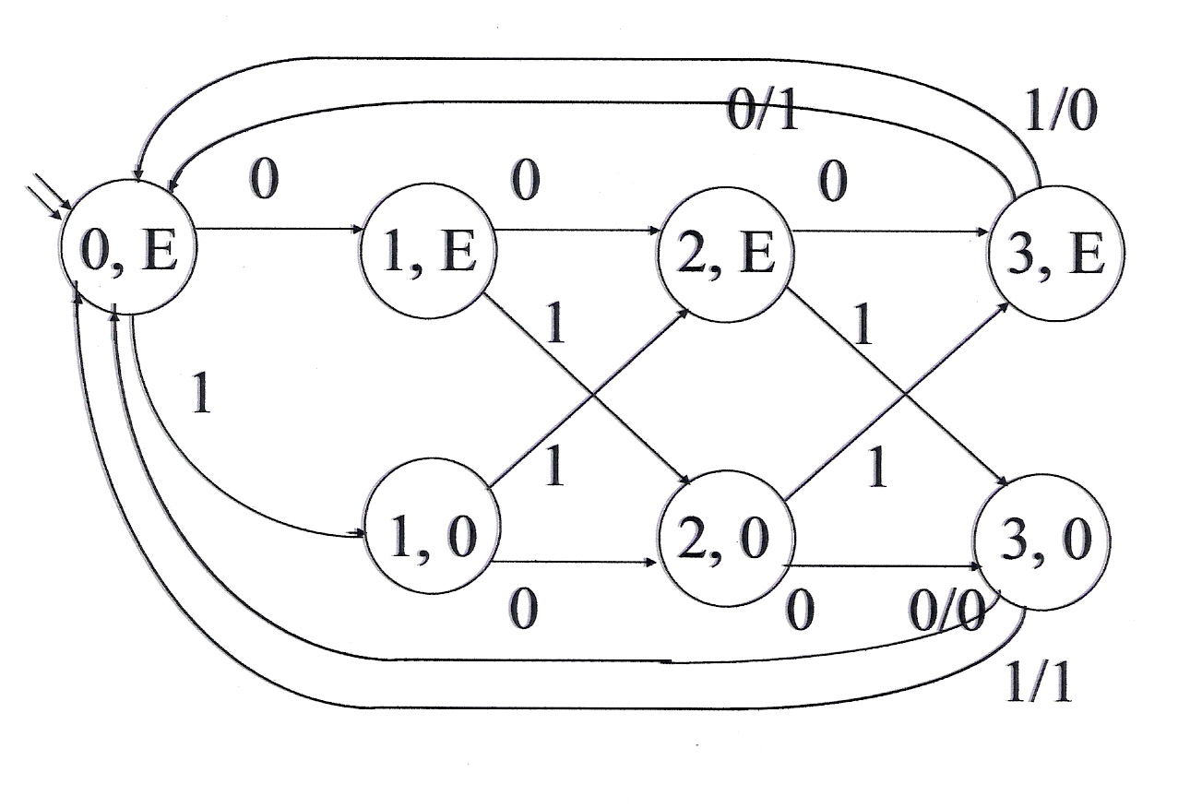
Recognizing Strings
Regular languages:
We care about recognizing patterns and taking appropriate actions.

Slide 40
Structure
Context free languages:
We care about structure.
E
E + E
id E * E
3 id id
5 7

Slide 41
Derivations
To capture structure, we must capture the path we took through the grammar. Derivations do that.
Example:
S → ε
S → SS
S → (S)
1 2 3 4 5 6
S ⇒ SS ⇒ (S)S ⇒ ((S))S ⇒ (())S ⇒ (())(S) ⇒ (())()
S ⇒ SS ⇒ (S)S ⇒ ((S))S ⇒ ((S))(S) ⇒ (())(S) ⇒ (())()
1 2 3 5 4 6
But the order of rule application doesn’t matter.

Slide 42
Parse Trees
A parse tree is an (ordered, rooted) tree that represents the syntactic structure of a string according to some formal grammar. In a parse tree, the interior nodes are labeled by nonterminals of the grammar, while the leaf nodes are labeled by terminals of the grammar.
A program that produces such trees is called a parser.
Parse trees capture the essential grammatical structure of a string.

Slide 43
Parse Trees
1 2 3 4 5 6
S ⇒ SS ⇒ (S)S ⇒ ((S))S ⇒ (())S ⇒ (())(S) ⇒ (())()
S ⇒ SS ⇒ (S)S ⇒ ((S))S ⇒ ((S))(S) ⇒ (())(S) ⇒ (())()
1 2 3 5 4 6
S
S S
( S ) ( S )
( S ) ε
ε
A parse tree may correspond to multiple derivations.
Parse trees are useful precisely because they capture the important structural facts about a derivation but throw away the details of the order in which the nonterminals were expanded.
The order has no bearing on the structure we wish to assign to a string.

Slide 44
Parse Trees
A parse tree, derived by a grammar G = (V, Σ, R, S), is a rooted, ordered tree in which:
● Every leaf node is labeled with an element of Σ ∪ {ε},
● The root node is labeled S,
● Every other node is labeled with some element of:
V – Σ, and
● If m is a nonleaf node labeled X and the children of m
are labeled x₁, x₂, …, x_{n}, then R contains the rule
X → x₁, x₂, …, x_{n}

Slide 45
Structure in English
S
NP VP
Nominal V NP
Adjs N Nominal
Adj N
the smart cat smells chocolate
It is clear from the tree that the sentence is not about cat smells or smart cat smells.

Slide 46
Generative Capacity
Because parse trees matter, it makes sense, given a grammar G, to distinguish between:
● G’s weak generative capacity, defined to be the
set of strings, L(G), that G generates, and
● G’s strong generative capacity, defined to be the
set of parse trees that G generates.
Which set is bigger?

Slide 47
Another Example on Expansion Order
Look at the parse tree for
the smart cat smells chocolate
From the parse tree, we cannot tell which of the following is used in derivation:
S ⇒ NP VP ⇒ the Nominal VP ⇒
S ⇒ NP VP ⇒ NP V NP ⇒
Again, parse trees capture the important structural facts about a derivation but throw away the details of the nonterminal expansion order
  The order has no bearing on the structure we wish to assign to a string.

Slide 48
Derivation Order
However, the expansion order is important for algorithms.
Algorithms for generation and recognition must be systematic.
They typically use either the leftmost derivation or the rightmost derivation.
A leftmost derivation is one in which, at each step, the leftmost nonterminal in the working string is chosen for expansion.
A rightmost derivation is one in which, at each step, the rightmost nontermial in the working string is chosen for expansion.

Slide 49
Derivations of The Smart Cat
the smart cat smells chocolate
A left-most derivation is:
S ⇒ NP VP ⇒ the Nominal VP ⇒ the Adjs N VP ⇒
the Adj N VP ⇒ the smart N VP ⇒ the smart cat VP ⇒
the smart cat V NP ⇒ the smart cat smells NP ⇒
the smart cat smells Nominal ⇒ the smart cat smells N ⇒
the smart cat smells chocolate
A right-most derivation is:
S ⇒ NP VP ⇒ NP V NP ⇒ NP V Nominal ⇒ NP V N ⇒
NP V chocolate ⇒ NP smells chocolate ⇒
the Nominal smells chocolate ⇒
the Adjs N smells chocolate ⇒
the Adjs cat smells chocolate ⇒
the Adj cat smells chocolate ⇒
the smart cat smells chocolate

Slide 50
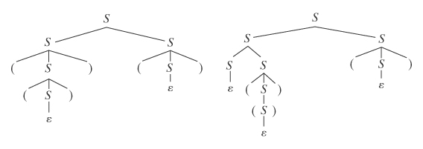
Ambiguity
A grammar is ambiguous iff there is at least one string in L(G) for which G produces more than one parse tree.
Even a very simple grammar can be highly ambiguous
S→ ε
S → SS
S → (S)

Slide 51
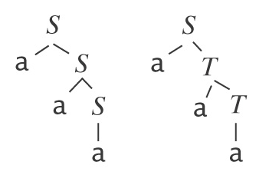
Regular Expressions and Grammars Can be Ambiguous Too
Regular Expression Regular Grammar
(a ∪ b)*a (a ∪ b)* S → a
S → bS
choose a from (a ∪ b) S → aS
choose a from (a ∪ b) S → aT
choose a T → a
T → b
choose a T → aT
choose a from (a ∪ b) T → bT
choose a from (a ∪ b)

Slide 52
Why Is Ambiguity a Problem?
With regular languages, for most applications, we do not care about assigning internal structure to strings.
With context-free languages, we usually do care about internal structure because, given a string w, we want to assign meaning to w.
We almost always want to assign a unique such meaning.
It is generally difficult, if not impossible, to assign a unique meaning without a unique parse tree.

Slide 53
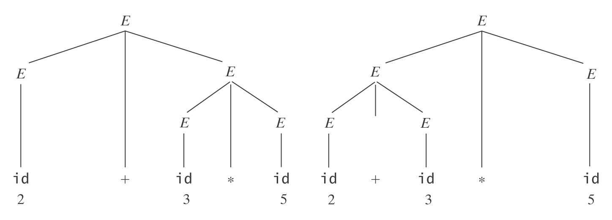
An Arithmetic Expression Grammar
E → E + E
E → E ∗ E
E → (E)
E → id

Slide 54
Inherent Ambiguity
Some languages have the property that every grammar for them is ambiguous. We call such languages inherently ambiguous.
Example:
L = {a^{n}b^{n}c^{m}: n, m ≥ 0} ∪ {a^{n}b^{m}c^{m}: n, m ≥ 0}.
Every string in L has either (or both) the same number of a’s and b’s or the same number of b’s and c’s.

Slide 55
Inherent Ambiguity
L = {a^{n}b^{n}c^{m}: n, m ≥ 0} ∪ {a^{n}b^{m}c^{m}: n, m ≥ 0}
One grammar for L has the rules:
S → S₁ | S₂
S₁ → S₁c | A /* Generate all strings in {a^{n}b^{n}c^{m}}.
A → aAb | ε
S₂ → aS₂ | B /* Generate all strings in {a^{n}b^{m}c^{m}}.
B → bBc | ε
Consider any string of the form a^{n}b^{n}c^{n}.
  They have two distinct derivations, one through S₁ and the other through S₂
  It is possible to prove that L is inherently ambiguous: given any grammar G that generates L, there is at least on string with two derivations in G.
Notes:
But two derivations do not mean two parse trees …

Slide 56
Inherent Ambiguity
Both of the following problems are undecidable:
Given a context-free grammar G, is G ambiguous?
Given a context-free language L, is L inherently
ambiguous?

Slide 57
But We Can Often Reduce Ambiguity
We can get rid of:
● ε rules like S → ε,
● rules with symmetric right-hand sides
  A grammar is ambiguous if it is both left and right recursive.
  Fix: remove right recursion
S → SS or E → E + E
● rule sets that lead to ambiguous attachment of
optional postfixes.
  dangling else problem: else goes with which if?
  if E then if E then S else S

Slide 58
Proving that G is Unambiguous
G is unambiguous iff, for all strings w, at every point in a leftmost or rightmost derivation of w, only one rule in G can be applied.
In other words,
A grammar G is unambiguous iff every string derivable in G has a single leftmost (or rightmost) derivation.

Slide 59
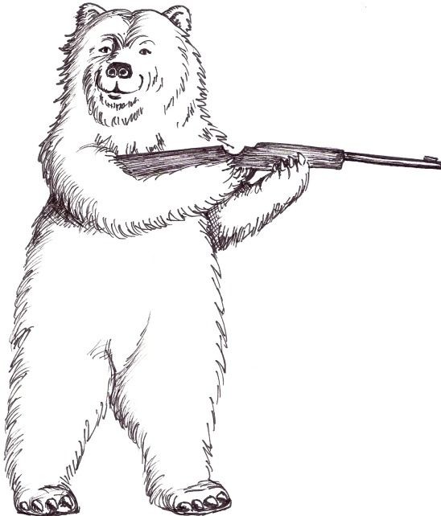
Going Too Far
Getting rid of ambiguity, but not at the expense of losing useful parse trees.
In the arithmetic expression example and dangling else case, we were willing to force one interpretation. Sometimes, this is not acceptable.
Chris likes the girl with a cat.
Chris shot the bear with a rifle.
Chris shot the bear with a rifle.

Slide 60
Comparing Regular and Context-Free Languages
Regular Languages Context-Free Languages
● regular exprs.
or
● regular grammars ● context-free grammars
● recognize ● parse

Slide 61
A Testimonial
Also, you will be happy to know that I just made use of the context-free grammar skills I learned in your class! I am working on Firefox at IBM this summer and just found an inconsistency between how the native Firefox code and a plugin by Adobe parse SVG path data elements. In order to figure out which code base exhibits the correct behavior I needed to trace through the grammar http://www.w3.org/TR/SVG/paths.html#PathDataBNF.
Thanks to your class I was able to determine that the bug is in the Adobe plugin. Go OpenSource!

Slide 62
Context-Free Grammars
Normal Forms

Slide 63
Normal Forms
A normal form F for a set C of data objects is a form, i.e., a set of syntactically valid objects, with the following two properties:
● For every element c of C, except possibly a finite set of
special cases, there exists some element f of F such
that f is equivalent to c with respect to some set of
tasks.
● F is simpler than the original form in which the elements
of C are written. By “simpler” we mean that at least
some tasks are easier to perform on elements of F than
they would be on elements of C.

Slide 64
Normal Forms
If you want to design algorithms, it is often useful to have a limited number of input forms that you have to deal with.
Normal forms are designed to do just that. Various ones have been developed for various purposes.
Examples:
● Clause form for logical expressions to be used in resolution
theorem proving
● Disjunctive normal form for database queries so that they can be
entered in a query by example grid.
● Various normal forms for grammars to support specific parsing
techniques.

Slide 65
Clause Form for Logical Expressions
Given:
[1] ∀x ((Roman(x) ∧ know(x, Marcus)) →
(hate(x, Caesar) ∨
∀y (∃z (hate(y, z) → thinkcrazy(x, y)))))
[2] Roman(Paulus)
[3] ¬hate(Paulus, Caesar)
[4] hate(Flavius, Marcus)
[5] ¬thinkcrazy(Paulus, Flavius)
Prove: ¬know(Paulus, Marcus)
Sentence [1] in clause form:
¬Roman(x) ∨
¬know(x, Marcus) ∨
hate(x, Caesar) ∨
¬hate(y, z) ∨
thinkcrazy(x, y)

Slide 66
Disjunctive Normal Form for Queries
The Query by Example (QBE) grid:
(category = fruit and supplier = Aabco)
(category = fruit or category = vegetable)
Category | Supplier | Price
Category | Supplier | Price
fruit | Aabco

Slide 67
Disjunctive Normal Form for Queries
(category = fruit or category = vegetable)
Category | Supplier | Price
fruit
vegetable

Slide 68
Disjunctive Normal Form for Queries
(category = fruit and supplier = Aabco)
or
(category = vegetable and supplier = Botrexco)
Category | Supplier | Price
fruit | Aabco
vegetable | Botrexco

Slide 69
Disjunctive Normal Form for Queries
But what about:
(category = fruit or category = vegetable)
and
(supplier = A or supplier = B)
This isn’t right:
Category | Supplier | Price
fruit | Aabco
vegetable | Botrexco

Slide 70
Disjunctive Normal Form for Queries
(category = fruit or category = vegetable) and
(supplier = Aabco or supplier = Botrexco)
becomes
(category = fruit and supplier = Aabco) or
(category = fruit and supplier = Botrexco) or
(category = vegetable and supplier = Aabco) or
(category = vegetable and supplier = Botrexco)
Category | Supplier | Price
fruit | Aabco
fruit | Botrexco
vegetable | Aabco
vegetable | Botrexco

Slide 71
Normal Forms for Grammars
Chomsky Normal Form, in which all rules are of one of the following two forms:
● X → a, where a ∈ Σ, or
● X → BC, where B and C are elements of V - Σ.
Advantages:
● Parsers can use binary trees.
● Exact length of derivations is known:
S
A B
A A B B
a a b B B
b b

Slide 72
Normal Forms for Grammars
Greibach Normal Form, in which all rules are of the following form:
● X → a β, where a ∈ Σ and β ∈ (V - Σ)*
Property: In every derivation that is produced by a GNF grammar, precisely one terminal is generated for each rule application.
This property is useful in several ways:
  Every derivation of a string w contains |w| rule applications.
    It is straightforward to define a decision procedure to determine whether w can be generated by a GNF grammar.
  GNF grammars can easily be converted to pushdown automata with no ε-transitions.
    This is useful because such PDAs are guaranteed to halt.

Slide 73
Normal Forms Exist
Theorem: Given a CFG G, there exists an equivalent Chomsky normal form grammar G_{C} such that:
L(G_{C}) = L(G) – {ε}.
Proof: The proof is by construction.
Theorem: Given a CFG G, there exists an equivalent Greibach normal form grammar G_{G} such that:
L(G_{G}) = L(G) – {ε}.
Proof: The proof is also by construction.

Slide 74
Stochastic Context-Free Grammars
Recall in Chapter 5, we introduced the idea of stochastic FSM: an NDFSM whose transitions have been augmented with probabilities that describe some phenomenon that we want to model.
We can apply the same idea to context-free grammar.
We can add probabilities to grammar rules and create a stochastic context-free grammar, also called probabilistic context-free grammar.

Slide 75
Stochastic Context-Free Grammars
A stochastic context-free grammar G is a quintuple:
(V, Σ, R, S, D):
● V is the rule alphabet,
● Σ is a subset of V,
● R is a finite subset of (V - Σ) ×V*,
● S can be any element of V - Σ,
● D is a function from R to [0 - 1].
D assigns a porbability to each rule in R.
D must satisfy the requirement that, for every nonterminal symbol X, the sum of the probabilities associated with all rules whose left-hand side is X must be 1.

Slide 76
Stochastic Context-Free Example
PalEven = {ww^{R} : w ∈ {a, b}*}.
But now suppose we want to describe a special case:
● a’s occur three times as often as b’s do.
G = ({S, a, b}, {a, b}, R, S, D):
S → aSa [.72]
S → bSb [.24]
S → ε [.04]

Slide 77
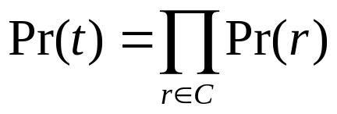
Stochastic Context-Free Grammars
The probability of a particular parse tree t:
Let C be the collection (in which duplicates count) of rules r that were used to generate t. Then:
Example:
S → aSa [.72]
S → bSb [.24]
S → ε [.04]
S ⇒ aSa ⇒ aaSaa ⇒ aabSbaa ⇒ aabbaa
.72 .72 .24 .04 = .00497664

